Slide 1
PowerShell 7 – What‘s new The road to PowerShell 7 and beyond
Sydney Smith, Program Manager Microsoft
https://devblogs.microsoft.com/powershell/ @sydneysmithreal
Notes:
Introduction

Slide 2
Session Roadmap
The road to PowerShell 7
The state of PowerShell
PowerShell 7 Milestone
PowerShell 7.1
Ecosystem Updates:
PowerShell/VSCode updates
SecretManagement
Notebooks/ForEach-Object –Parrallel
Predictive Intellisense
Crescendo
What’s Next
Powershell 7.2
PowerShellGet 3.0
PowerShell Gallery Operations updates

Slide 3
Windows PowerShell 1.0 – 2.0
COM
Registry
Win32
Files
.NET
WMI/CIM

Slide 4
Windows PowerShell 3.0 – 5.0
Networking
Security
Identity
Storage
COM
Registry
Hyper-V
Win32
Files
.NET
WinRM Remoting
WMI/CIM

Slide 5
PowerShell Core 6.x: Ubiquity!
Cloud
Azure/ARM
AWS
GCP
VMware
Distributions
Docker
CI/CD platforms
.NET SDK
Portability
REST / JSON
Networking
SSH
Security
Identity
Storage
OS
Linux
macOS
COM
Registry
Win32
Hyper-V
Files
.NET
WinRM Remoting
WMI/CIM

Slide 6
PowerShell Core 6.x: Ubiquity!
Distributions
Docker
CI/CD platforms
.NET SDK
Portability
Cloud
Azure/ARM
AWS
GCP
VMware
REST / JSON
Networking
SSH
Note this portion outside the circle was Windows compatibility that we (temporarily) lost in the transition to .NET / PowerShell Core
Security
Identity
Storage
OS
Linux
macOS
COM
Registry
Win32
Hyper-V
Files
.NET
WinRM Remoting
WMI/CIM

Slide 7
PowerShell 7
Distributions
Docker
CI/CD platforms
.NET SDK
Portability
Cloud
Azure/ARM
AWS
GCP
VMware
REST / JSON
With .NET Core 3.1, and our own efforts to port inbox Windows modules, support for the vast majority of these APIs, features, and cmdlets have returned
Networking
Security
Identity
SSH
COM
Storage
OS
Linux
macOS
Registry
Win32
Hyper-V
Files
.NET
WinRM Remoting
WMI/CIM

Slide 8
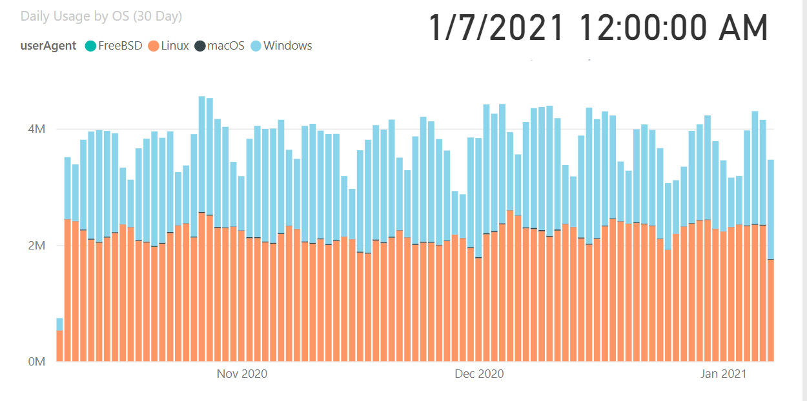
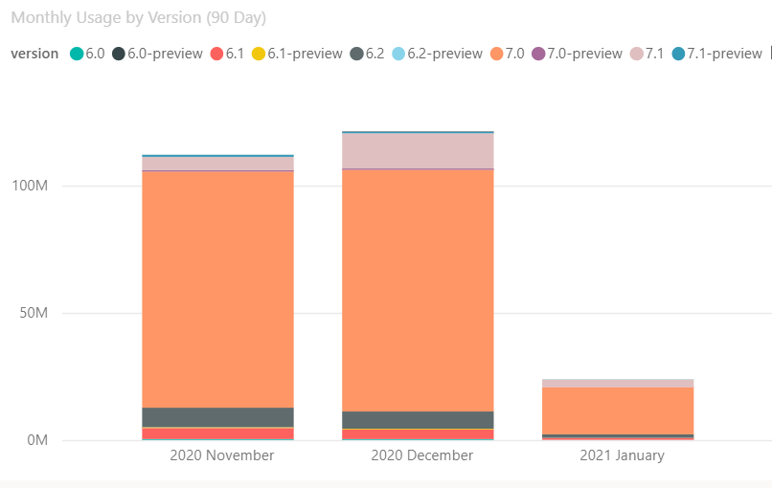
The State of PowerShell

Slide 9
PowerShell 7 Milestone (March 2020)
Windows PS Compatibility
Additional module validation
Windows PowerShell wrapper
.NET Core 3.1
New installation options
Affinity to the Cloud
Cloud Shell
Docker Distributions
Alignment with partners like Azure PowerShell
SecretManagement
Great Tooling
PSReadLine 2.0
PowerShellEditorServices 2.0
Telemetry++
Top Customer Requests
Local policy support
Invoke-DscResource
ForEach-Object –Parallel
Updated ErrorView
New version notification
Ternary operator
Chain operators (&& and ||)
Null conditional assignment

Slide 10
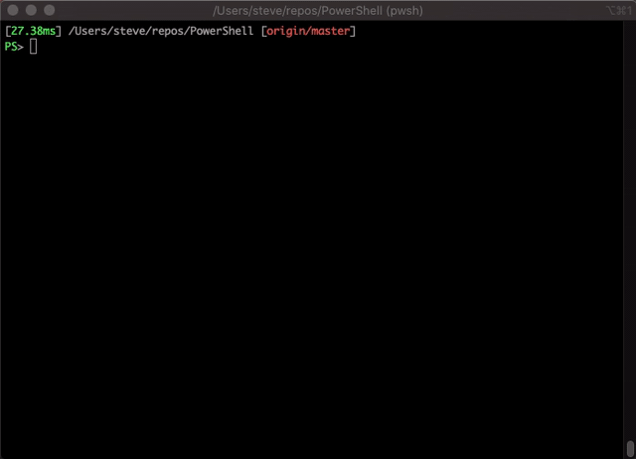
Chain Operators

Slide 11
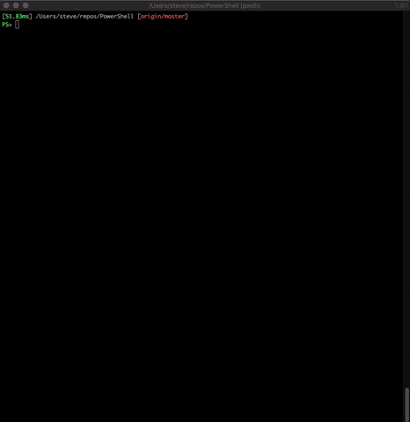
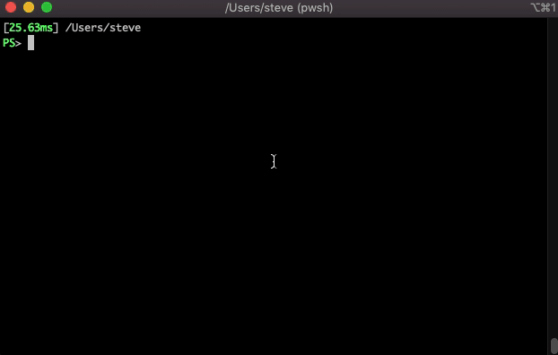
New Error View

Slide 12
PowerShell 7.1 Milestone
Released November 2020
Built on .NET 5, the first PowerShell to ship within 24 hours of a .NET GA
Quality-of-life improvements and addresses many community-filed GitHub issues
First PowerShell GA available in the Microsoft Store

Slide 13

What’s New in the PowerShell ecosystem

Slide 14
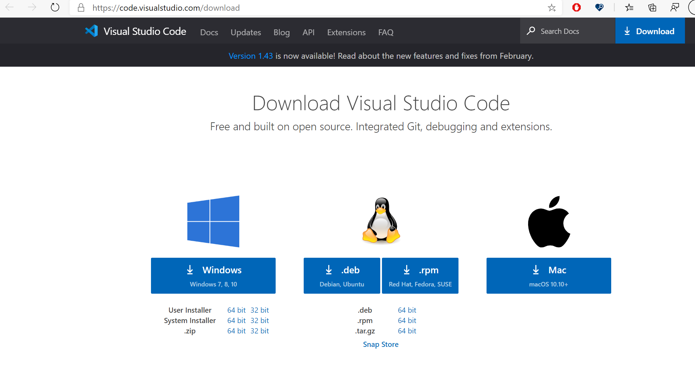
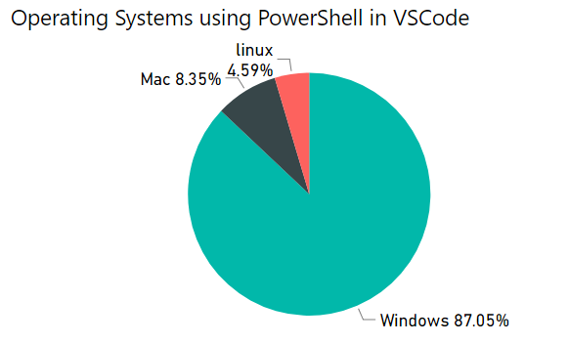
Visual Studio Code Extension
Features
Syntax highlighting
Code snippets
IntelliSense for cmdlets and more
Rule-based analysis provided by PowerShell Script Analyzer
Go to Definition of cmdlets and variables
Find References of cmdlets and variables
Document and workspace symbol discovery
Run selected selection of PowerShell code using F8
Launch online help for the symbol under the cursor using Ctrl+F1
Local script debugging and basic interactive console support!

Slide 15
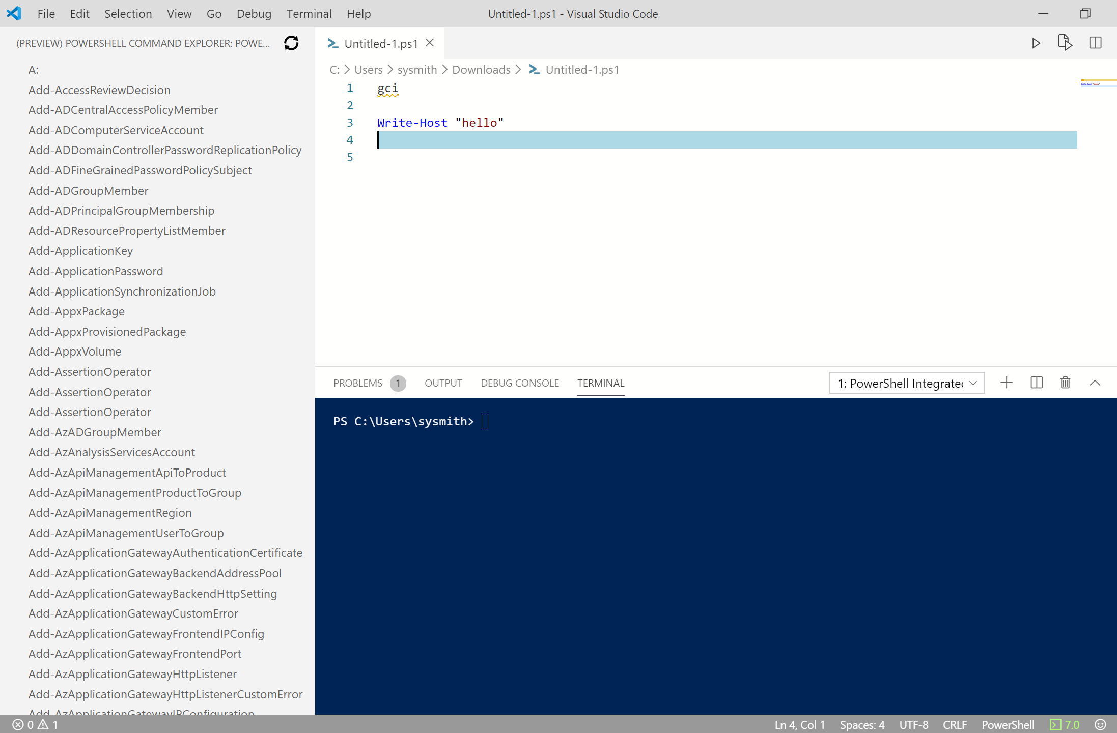
PowerShell Extension for VSCode– Major Release
Major Performance improvements
Full PSReadLine support
ISE Mode

Slide 16
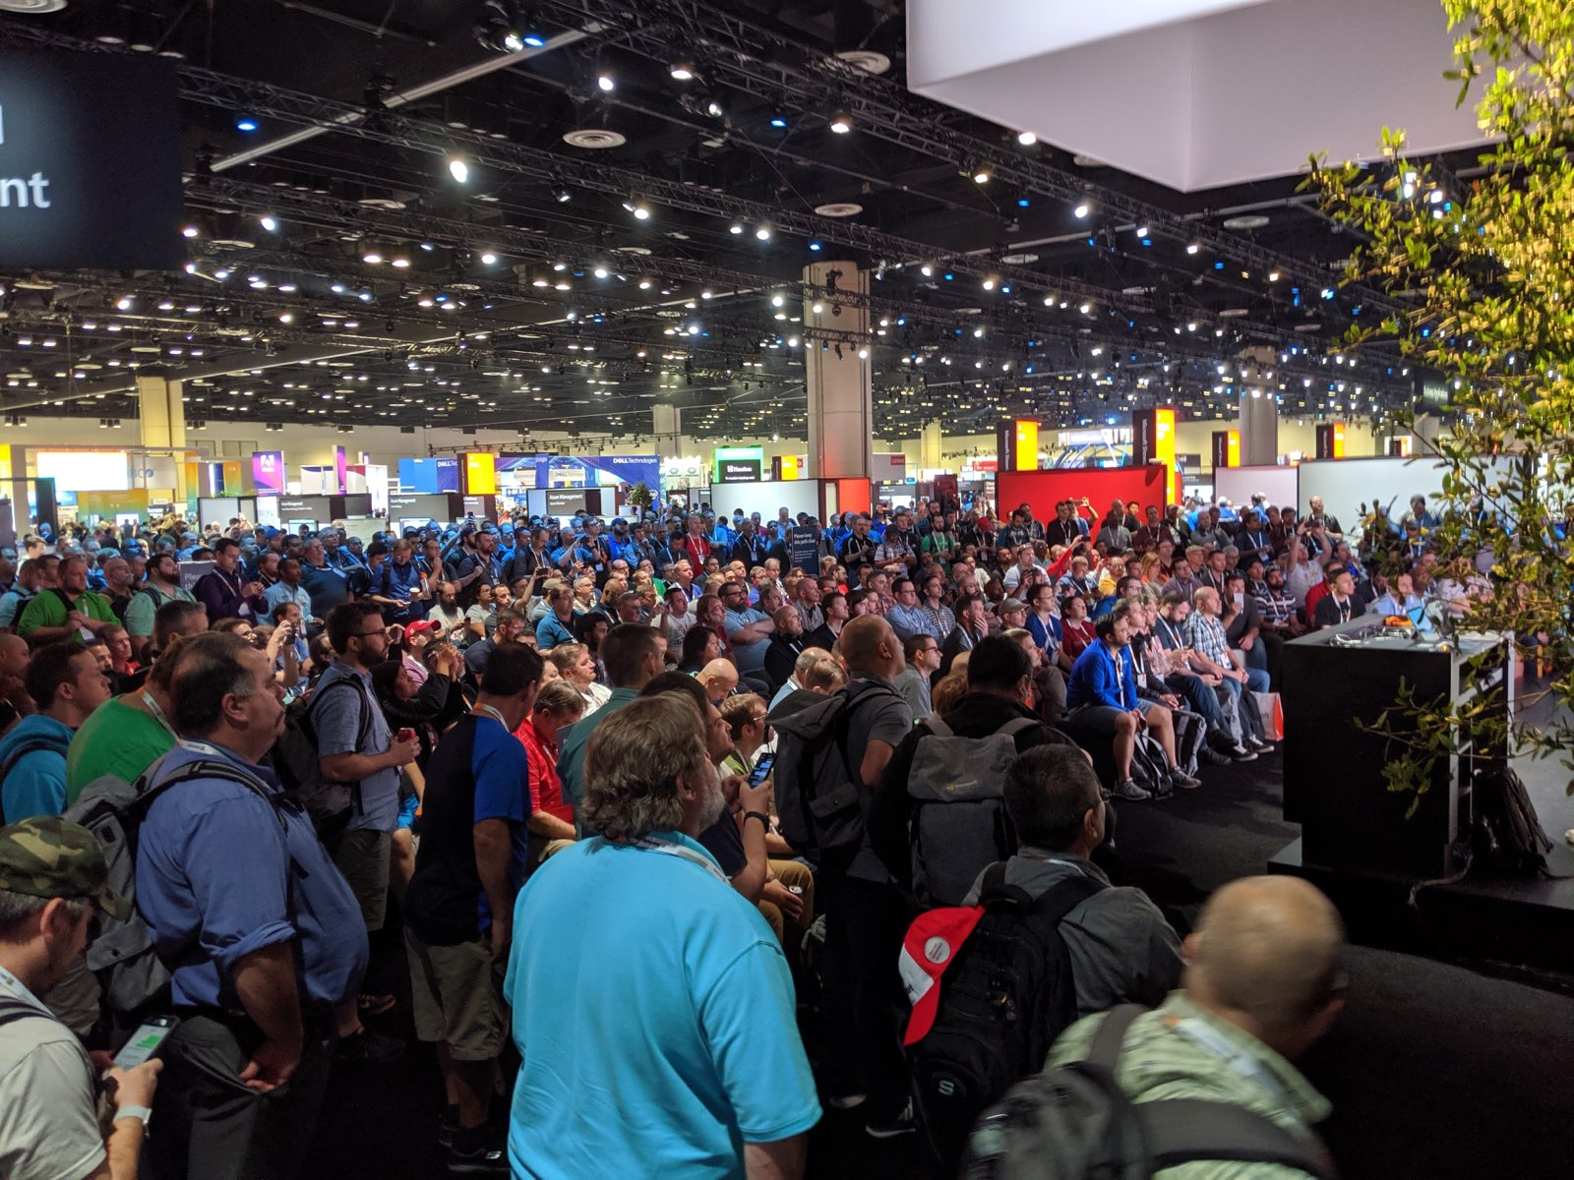
Secret Management - Customer Feedback
It is difficult to manage secrets securely in heterogeneous cloud environments
Advanced scripts require multiple secrets and types of secrets when orchestrating across different clouds
Custom code is required to securely manage secrets across platforms
High stakes because of security implications

Slide 17
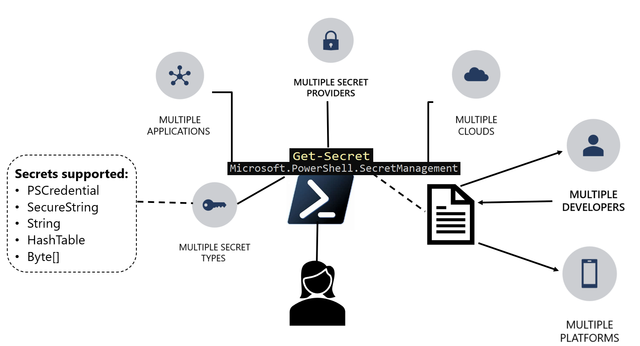
SecretManagement Module (RC is available)

Slide 18
Key Scenarios
Sharing a script across my org (or Open Source) without knowing the platform/local vault of all the users
Running my deployment script in local, test and production with the change of only a single parameter (-Vault)
Changing the backend of the authentication method to meet specific security or organizational needs without needing to update all my scripts
A convenience feature which allows users to simplify their interactions with various vaults by only needing to learn a single set of cmdlets

Slide 19
SecretManagement is valuable in heterogeneous environments where you may want to separate the specifics of the vault from a common script which needs secrets.

Slide 20
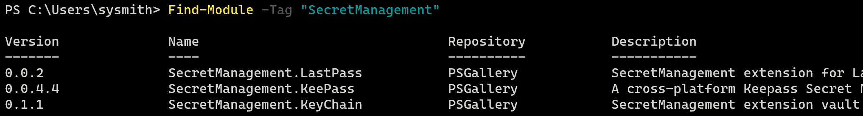
The Vault Ecosystem
The value of SecretManagement comes from the vault ecosystem
Extension vaults are just PowerShell modules with a particular structure
Leave the advanced key management up to the vault
Leave authentication management up to the vault
Vaults will be owned and supported by Vault owners/community users and published/distributed through the PowerShell Gallery
Use the “SecretManagement” tag to identify vaults on the PowerShell Gallery

Slide 21
SecretStore (Microsoft.Powershell.SecretStore)
Extension vault module shipped by the PowerShell Team
Currently available as a Public Preview
Installed from the PowerShell Gallery
Stores secrets locally on file for the current user, and uses .NET Core cryptographic APIs to encrypt file contents
This extension vault works over all supported PowerShell platforms on Windows, Linux, and macOS
Has configuration settings to adapt to your scenario
Takes advantage of common security “best practices” but may not meet the security requirements for every scenario

Slide 22
Notebooks
Combine rich text elements and executable code
Notebooks are both human-readable documents containing the analysis description and the results (figures, tables, etc..) as well as executable documents
Originated in the data science/data visualization world
A notebook kernel is a “computational engine” that executes the code contained in a Notebook
Run in a variety of local and hosted environments

Slide 23
PowerShell Notebook Kernel
Currently in Public Preview
GA is expected when integration points are complete (VSCode etc.)
Leveraging the .NET interactive kernel (get daily builds from https://github.com/dotnet/interactive )
Targeting a support & learning docs as key scenarios
Key Partners:
Azure Data Studio
SQL Support
SharePoint Support
Azure Support
.NET Interactive
VSCode
Azure Notebooks

Slide 24
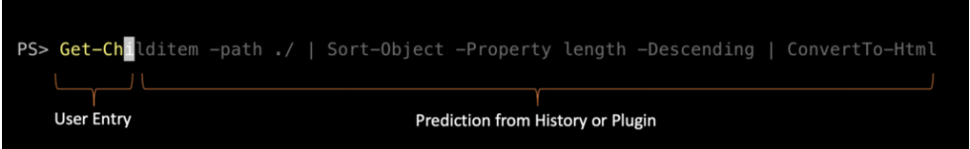
Predictive Intellisense
Available on the PowerShell Gallery in PSReadline 2.1, and in PS 7.1
This enables new and experienced users of PowerShell to discover, edit, and execute full commands based on matching predictions from the user’s history and additional domain specific plugins
Predictive IntelliSense in PSReadLine 2.2 will include an extension model to support the registration of additional providers. Additional providers enhance predictions by providing domain specific command and task completions
PSReadLine 2.2.0-beta1 currently available for download from PSGallery

Slide 25
Crescendo (Native Command Proxy Tool)
Preview 1 is currently available on the PowerShell Gallery
A framework to rapidly develop PowerShell cmdlets for native commands, regardless of platform
Provides the tools to easily wrap a native command to gain the benefits of PowerShell cmdlets
Provide parameter handling like prompting for mandatory parameters and tab-completion for parameter values
Input and Output object support
The output objects allow you to take advantage of all the post processing tools such as Sort-Object, Where-Object, etc.

Slide 26
What’s next?

Slide 27
PowerShell 7.2 Milestone
Preview releases are already shipping
Continuing to follow the .NET lifecycle
Create greater affinity to Cloud Services
Continue to invest in PowerShell ubiquity
PSReadline and PowerShellGet updates

Slide 28
PowerShellGet 3.0
Move to pure C#-based module w/ no provider model (i.e. no dependency on OneGet or nuget)
Addressing top voted issues:
Local repository cache for faster search
Multi-repository priority
Version range/wildcard support
Dependency management
Upgrade stories
Tracking release milestones on GitHub
Notice a repo change (PowerShellGetv2)

Slide 29
PowerShell Gallery Operations
Making changes to meet the changing scale needs of the Gallery
Detect:
Add more notifications to the production database
Create alerts for when critical metrics are reached in the DB
Improve post-deployment validation so that we can quickly roll back undesirable changes
Diagnose:
Send database logs to a central location outside of the service so that logs are more easily available
Fix:
Improve the deployment process for gallery cloud services
Better document (internal) procedures for recovery and communication during an outage

Slide 30
Call to Action
Use PowerShell 7
Try out our ecosystem improvements
Engage with us in open source!
Try out our PS and module previews
File issues
Contribute docs and code

Slide 31
How to stay connected
PowerShell community call: aka.ms/PSCommunityCall
PowerShell Org on GitHub: github.com/powershell
@PowerShell_Team on Twitter
PowerShell blog PowerShell | Automating the world one-liner at a time… (microsoft.com)

Slide 32









Thanks to our Sponsors!

